Slide 1

Bryterdays
There’s always an event

Slide 2



The Problem
I SHOULD…
Keeping track of all the daily life tasks, activities and interests is time and effort consuming. This can lead to a frustrating procrastination.
TAKE IT SERIOUSLY
BUT HOW
AND WHEN ?
I’LL DO IT
TOMORROW
LET’S DO SOME
RESEARCH

Slide 3



Value Proposition
What if the community could help me out
to build and plan things through…
Collective intelligence, from which experience and knowledge are
shared on planning events
A single platform containing
smart and organized calendars
on any subject
A customized agenda for your
own need

Slide 4









The Solution
Bryterdays the smart calendars market place
Platform
Mobile App
Partner
Store
User
Smart Calendar
Design
Publishing
Customized User Calendar
Validation
Pricing

Slide 5

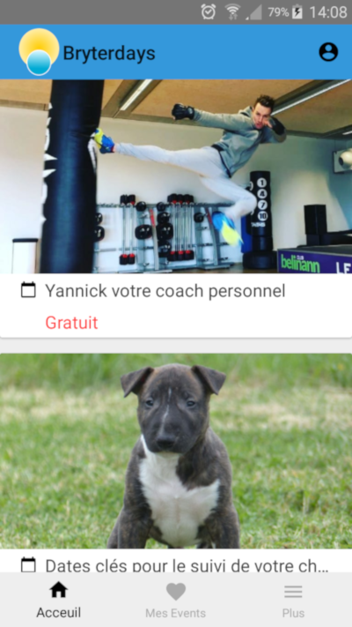
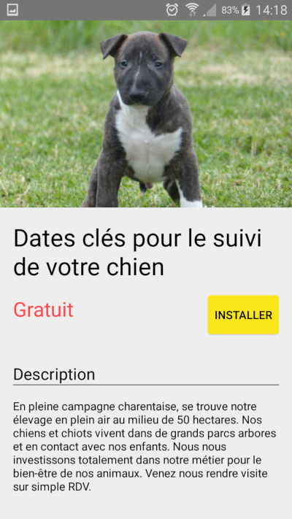
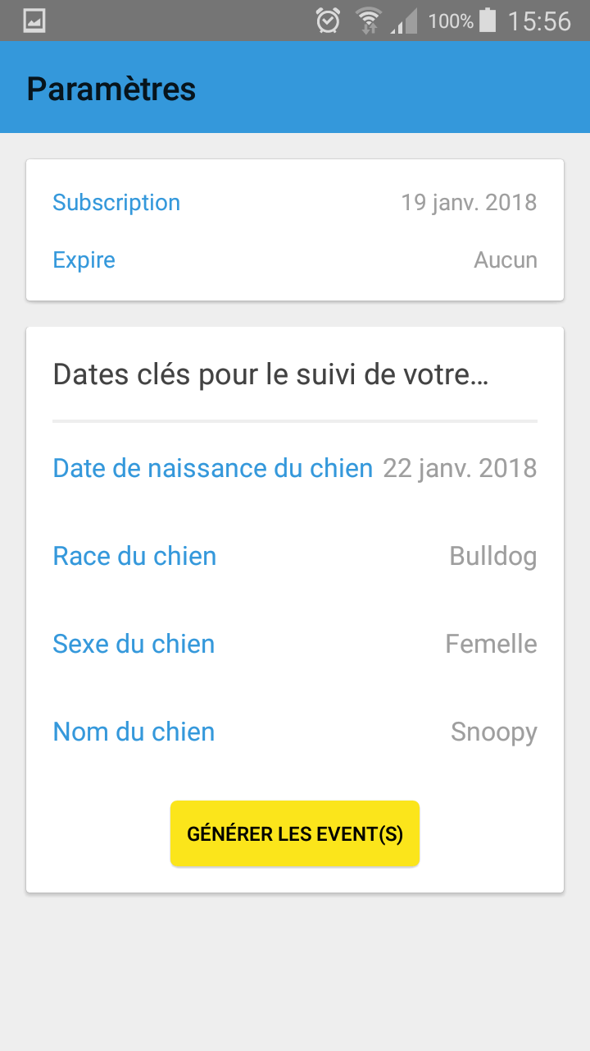
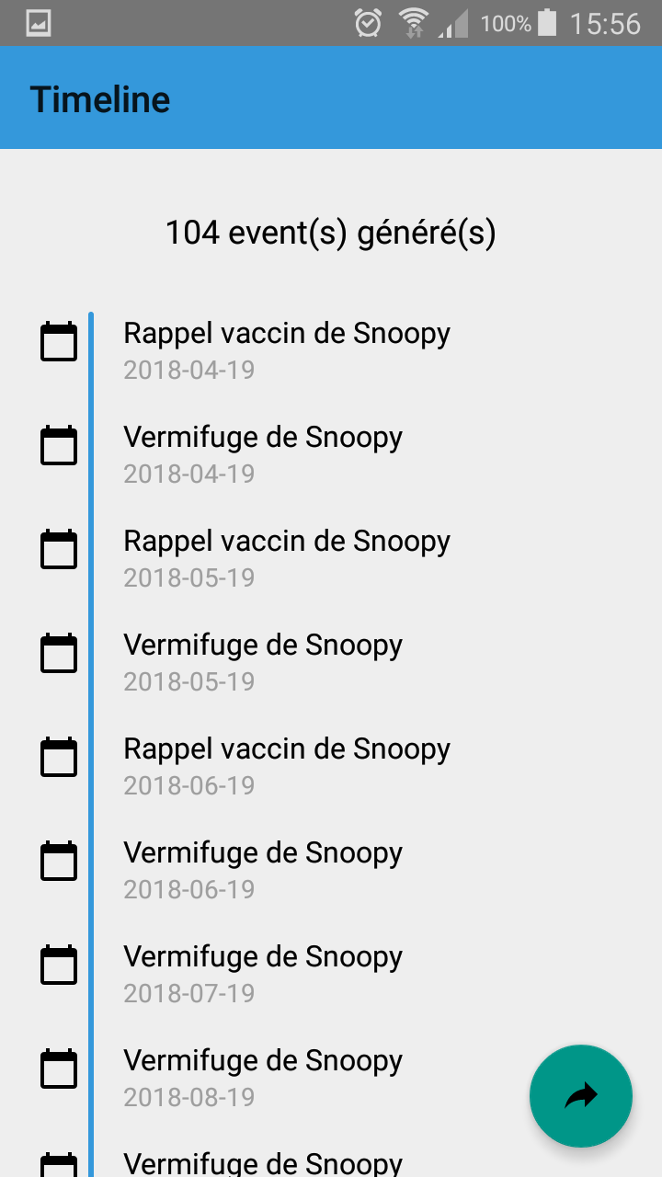
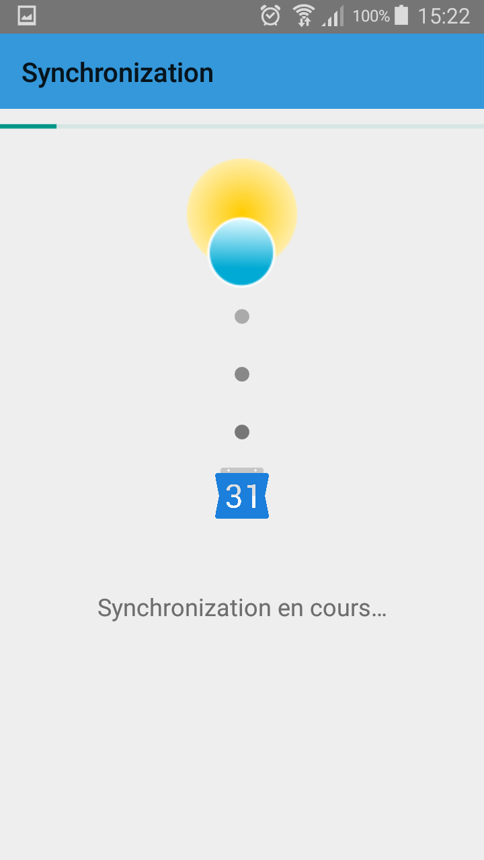
The Product
Follow the magical recipe…
Browse available
smart calendars designed by our partners
Choose and install
Set required inputs defined by the partner
Preview generated
events
Synchronize one of your calendar

Slide 6



Business Model
20% fee for every payable services
Contracted staff for custom
service developments
Dedicated tools for premium users to sustain and help providers business (recommendations, market trend,…)

Slide 7
Go-to-Market Plan
3 aquisition channels
ORGANIC GROWTH
SEGMENTATION
MARKETING
Target Partners first
Easy-to-use back office
Small businesses with low native digital emphasis
Businesses where support activity has a huge impact on business as usual
Deep human related interaction
Eg: Dog breeder, Personal coach, Wedding planner,…
Local campaigns
Customer word of mouth
Partner acquisition channel
Calendars powered by Bryterdays

Slide 8








Competitive Landscape
Assistant
Bryterdays
Bryterdays
Siri
Calendar
Events
platform
Google Calendar
Eventbrite
iCal
Outlook
Bryterdays
Organizer

Slide 9
Traction & Key Metrics
(TODO)

Slide 10
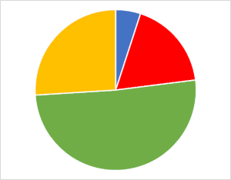
Accomplishment, Funding request and Use of funds
Admin expenses
Sales and support
Operational costs
250K€
In Seed Capital
Product Development
Enroll up to 10 partners
Monetization process
Public Beta
Public Office
Dec 2018
Fev 2019
Jul 2019
Sept’ 2018
Jan’ 2019
June’ 2019
Dec’ 2019
Office Beta
Close seed round investment
Reach 100 partners

Slide 11

Team Management
Jérôme Poté
Madjid Belaïd
IT Manager and Co-founder
Business Developer and Co-founder
8y development
8y Off-shore coordination, Project Managment, Business Analyst
5y abroad
Uni class friends (18 years)

Slide 12
Vision
MID-TERM
LONG-TERM
GOAL… 1 chacun pour le fun ;)
Self Office (Visual Studio, Reporting, Customer surveys,…)
Calendar events enrichment (Suggestions, Geolocation, Multimedia, …)
Bryterdays Board (Unified calendars, Social Networking, Data Privacy,…)
Automated organizer
Internet Of Thing
Bryterdays at the service
Artificial Intelligence
Events oriented Operating System

